Slide 1


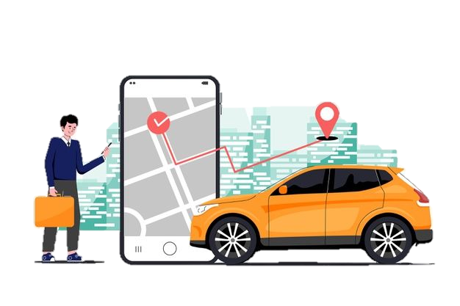
DEEPARTMENT OF MASTER IN COMPUTER APPLICATION
MAJOR PROJECT
ON
VEHICLE RENTAL SYSTEM
UNDER THE GUIDENCE OF : RAKESH KU. BHOLE (BCPL PYTHON DEVEOPER) DR. MADHUMITA PANDA (H.O.D) | PRESENTED BY : KRISHNA BAJPAYEE REGD. NO. : 1925201006 JAGANNATH PATRA REGD. NO. : 1925201005

Slide 2
CONTENT
Introduction
OBJECTIVE
Project scope
Existing System
Proposed System
Hardware Specifications
Software Specifications
Modules
E-r diagram
Use case model
screenshot
Functional requirements
conclusion

Slide 3
INTRODUCTION
This is a python Django project on vehicle rental system, which provide a lot of facility to their business.
Vehicle rental system is a rental service that provides vehicles on rent.
It will record the details of various activities of customers as well as information about booking.
It offers the online vehicle hire service.
It offers the best of rates and include the different categories of vehicles from luxury to budget.

Slide 4
OBJECTIVE
This system helps the administration to maintain all details of the customers details, owner details, vehicles details, booking details.
User friendly software
The system should provide up to date accurate information at any time.

Slide 5
PROJECT SCOPE
The scope of the software product developed involves paid services to the customers for rent a number of vehicles.
It involves a very simple registration procedure.
Provide vehicle catalog for users as an alternative for them to select vehicle of they want to choose vehicle by their own.

Slide 6
Existing system
In the present system, organizations do maintain a person for the allocating and proper functioning of transportation.
Authorized person maintains the transportation details
in papers.
Problems in Existing System
Details are stored in papers.
Maintenance is a huge problem.
Updations, changes in details in a difficult task.
Performance is not achieved up to the requirements.

Slide 7
PROPOSED SYSTEM
The proposed system overcome the problems in the Existing system
Advantages of proposed system
Data is centralized which has overcome the sharing problems in previous system
As data is maintained electronically ,it’s easy for a person to update the details, which has overcome the difficult update in previous system.
Maintenance is easy and performance is good.

Slide 8
SOFTWARE SPECIFICATIONS
Platform : Windows 10, Ubuntu
Language : Python, HTML, CSS, JavaScript
Framework : Django
Database : SQLite3
Web Server : Django Default Web Server

Slide 9
Hardware Specifications
Processor : Intel Core i3
Hard Disk : 500 Gb
RAM : 4 Gb

Slide 10
MODULES
This project contain three modules
Admin module
Owner module
Customer module

Slide 11
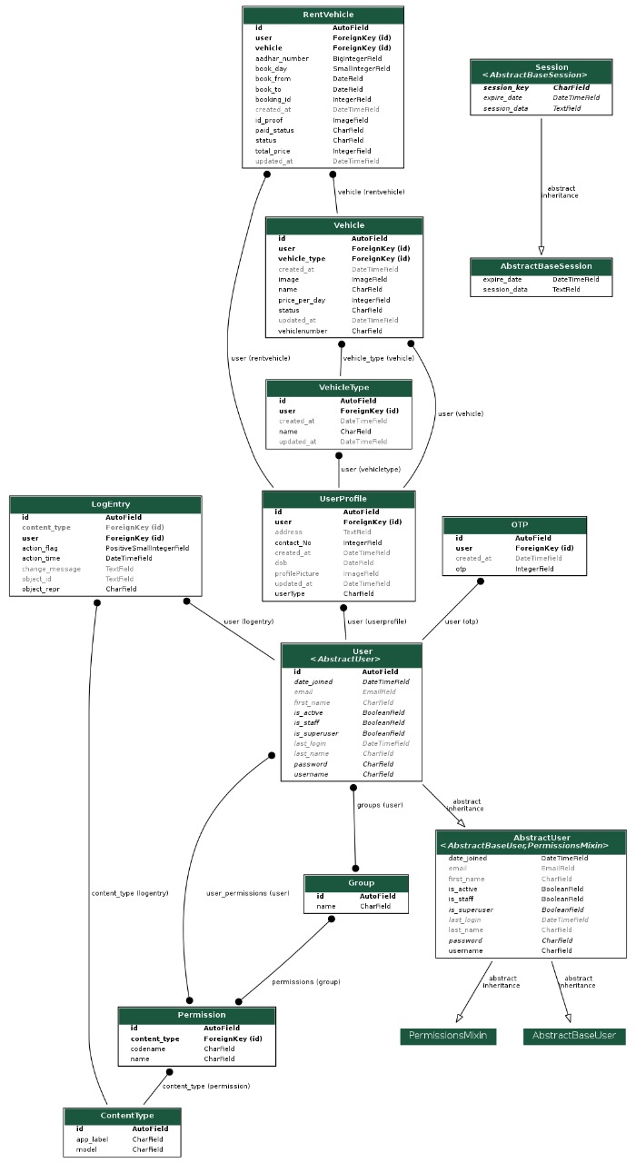
ENTITY RELATIONSHIP DIAGRAM

Slide 12
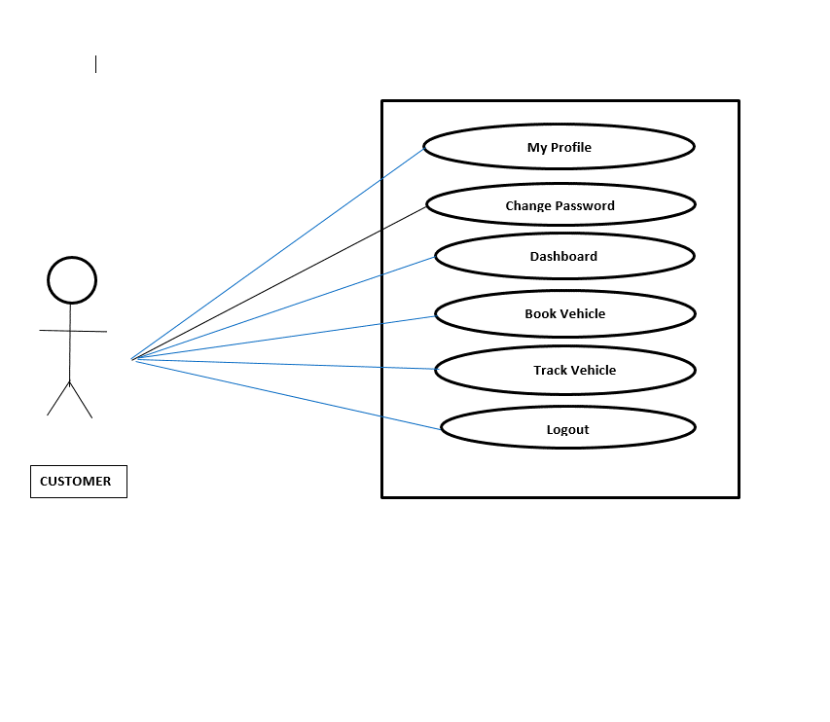
USE CASE MODEL FOR CUSTOMER

Slide 13
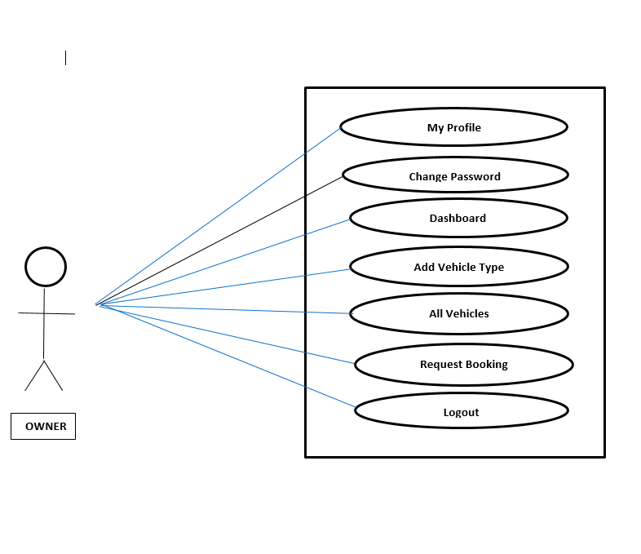
USE CASE MODEL FOR VEHICLE OWNER

Slide 14
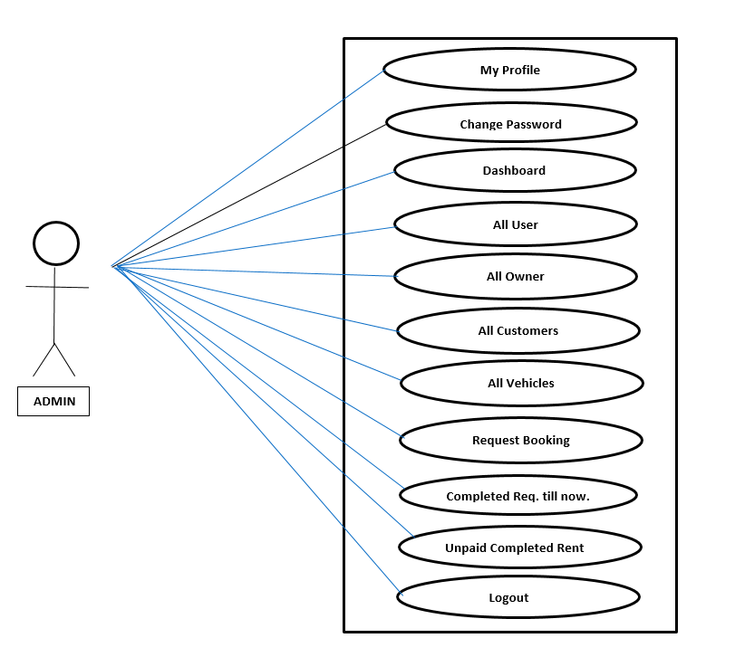
USE CASE MODEL FOR ADMIN

Slide 15
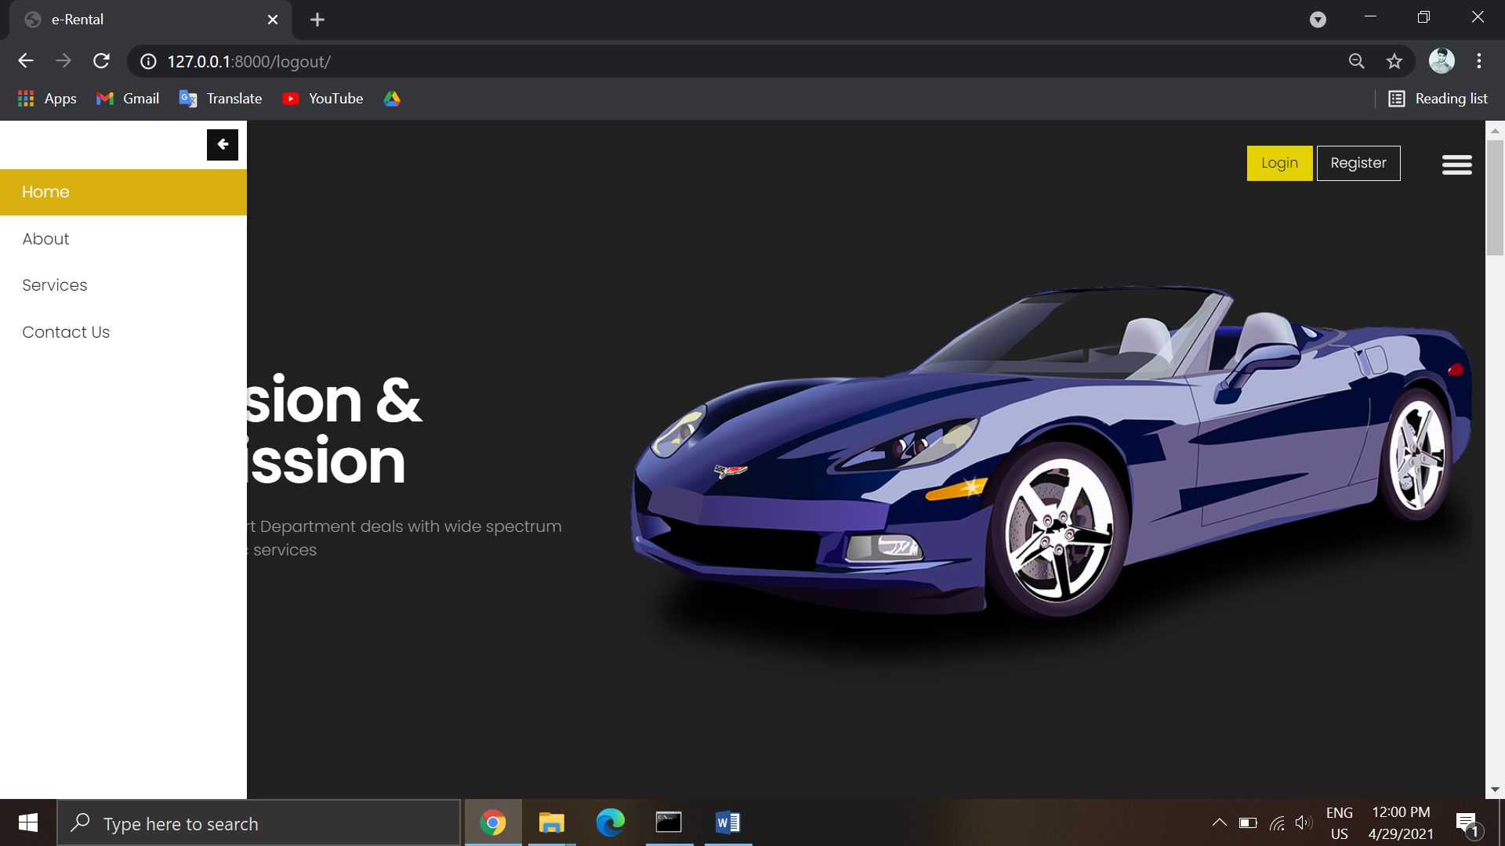
SCREENSHOTS

Slide 16
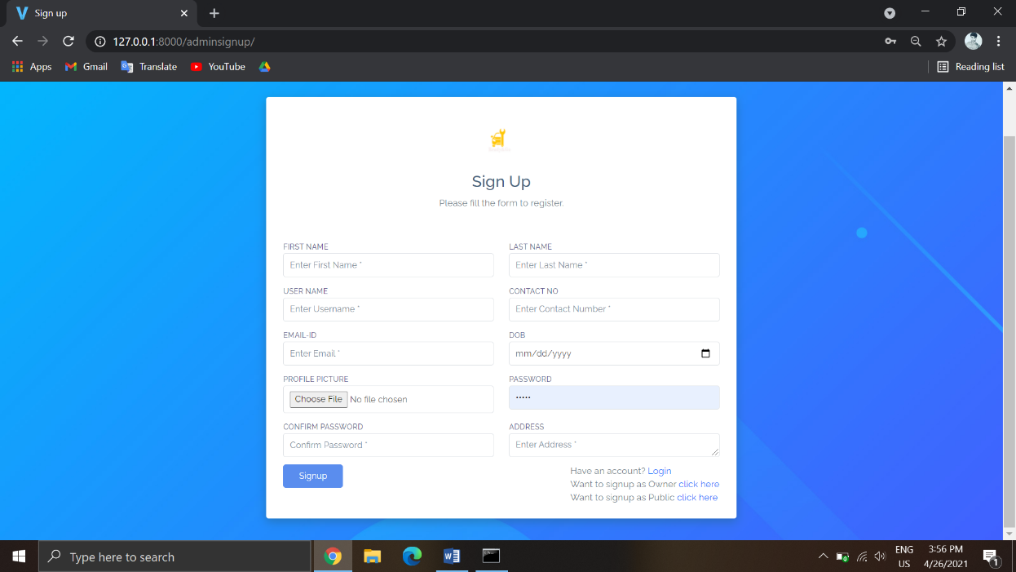
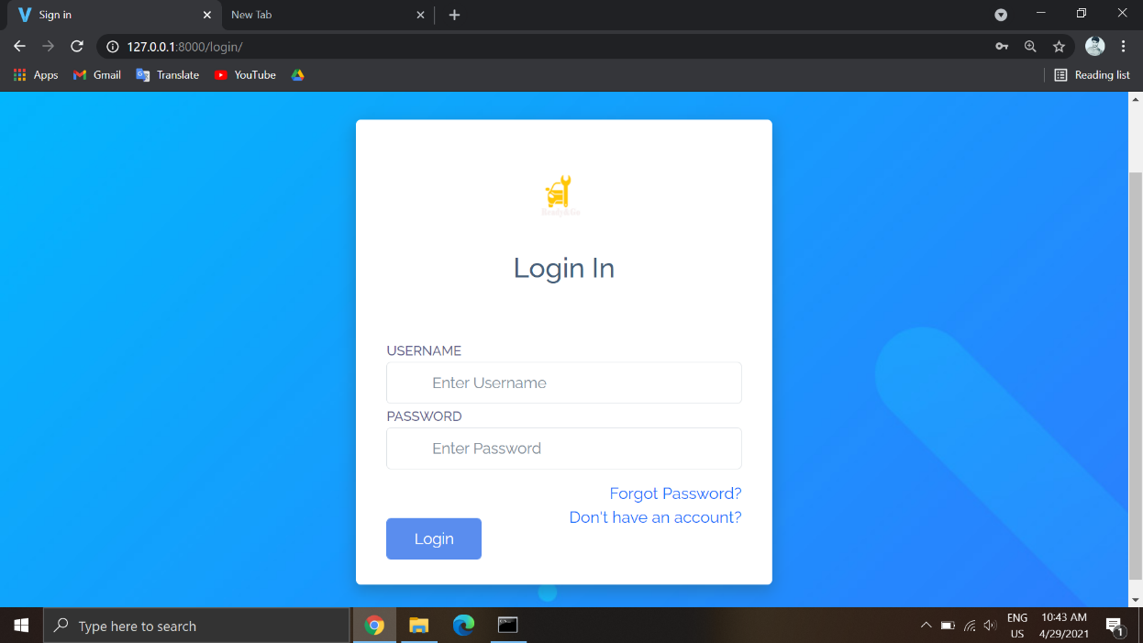
REGISTER AND LOGIN PAGE

Slide 17
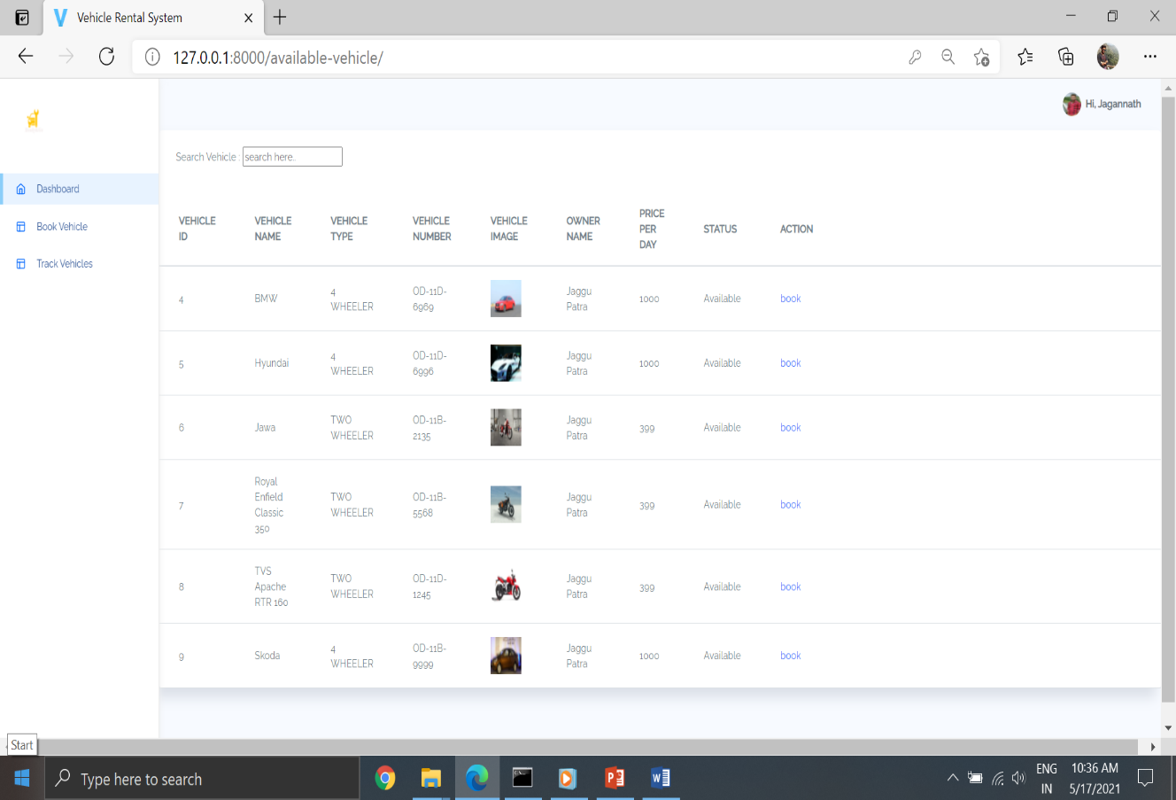
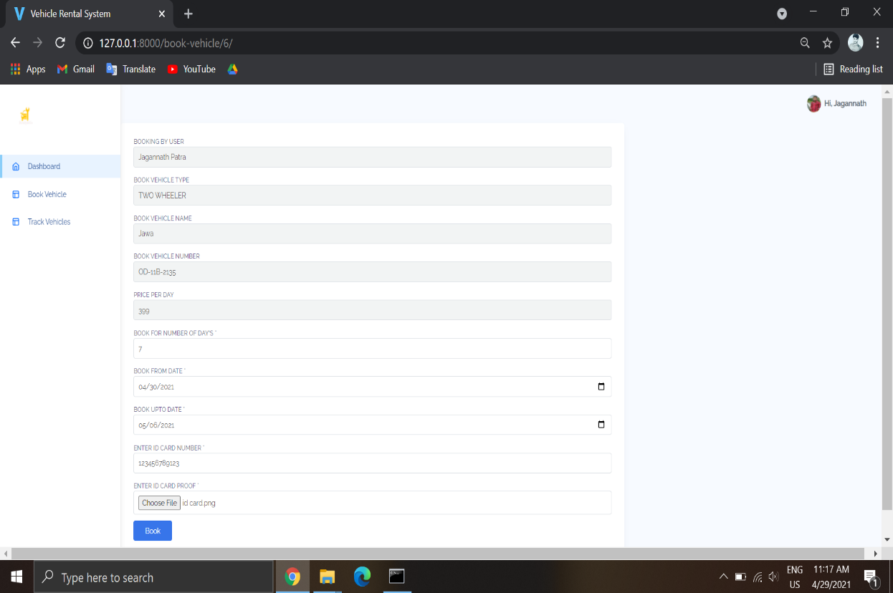
CUSTOMER

Slide 18
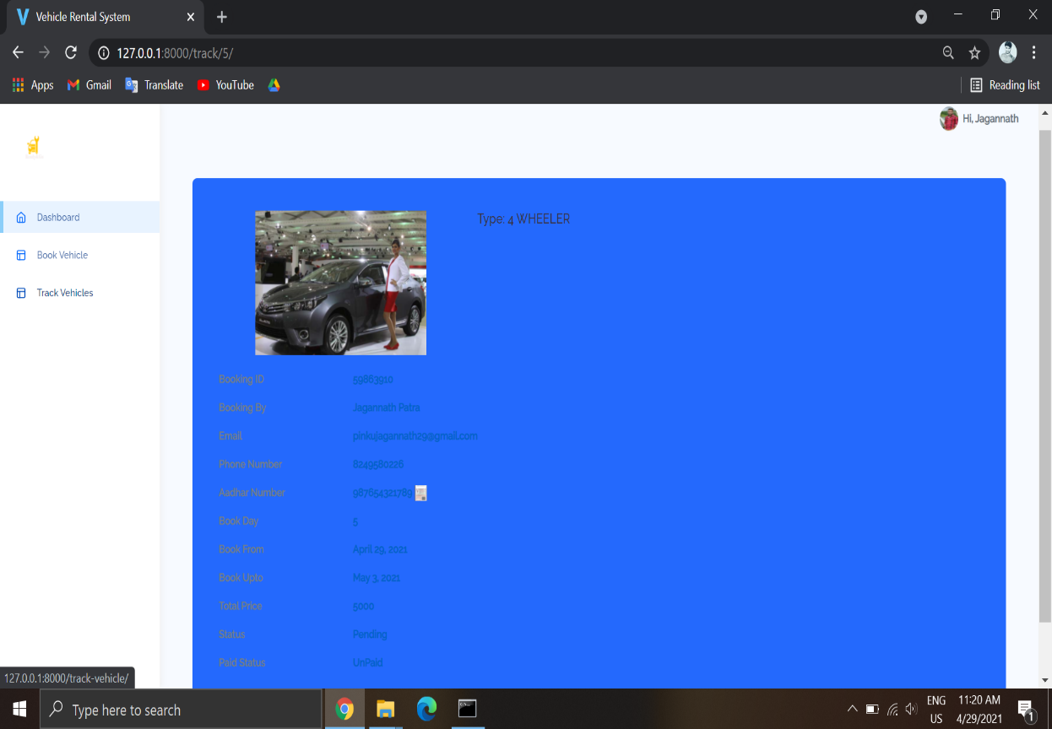
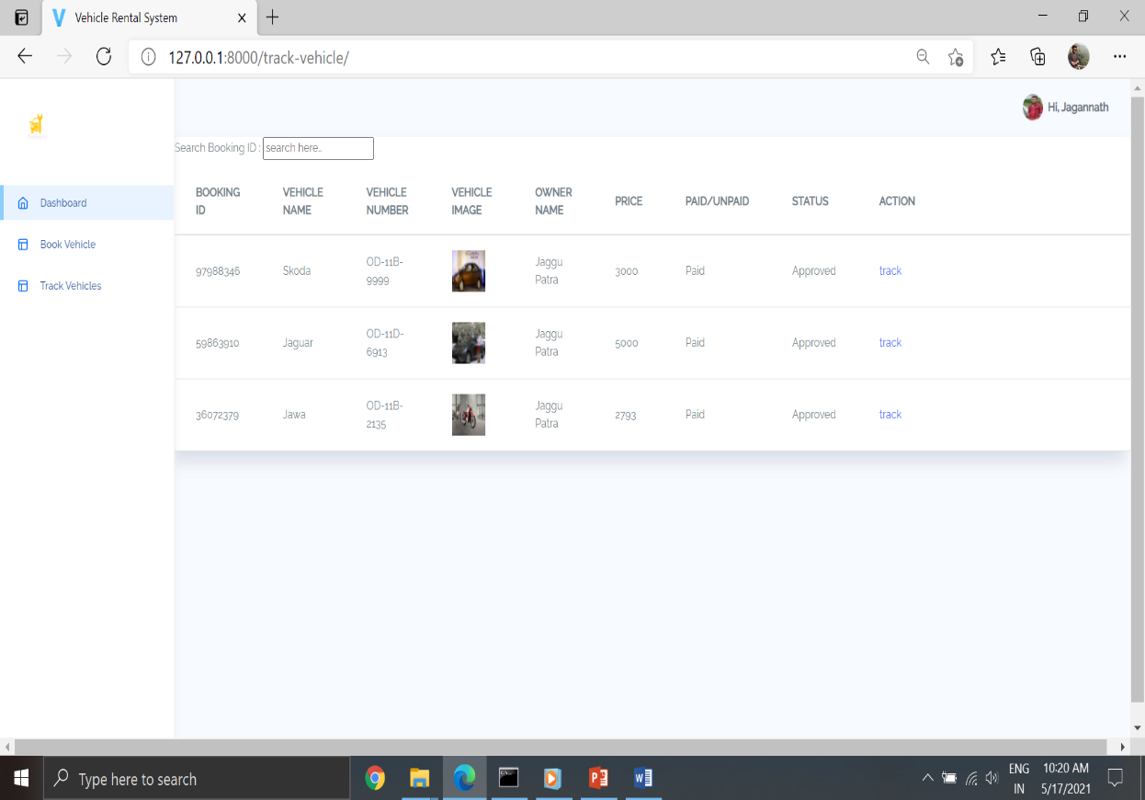
CUSTOMER

Slide 19
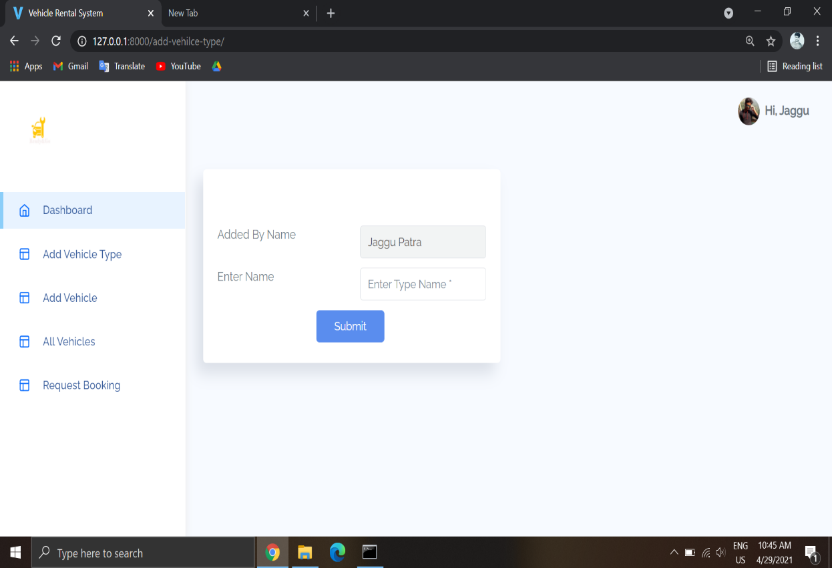
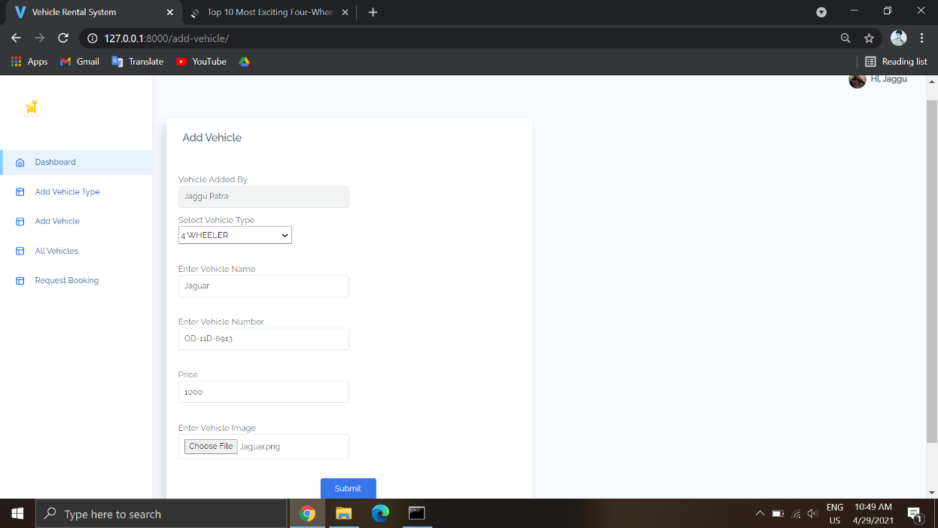
OWNER

Slide 20
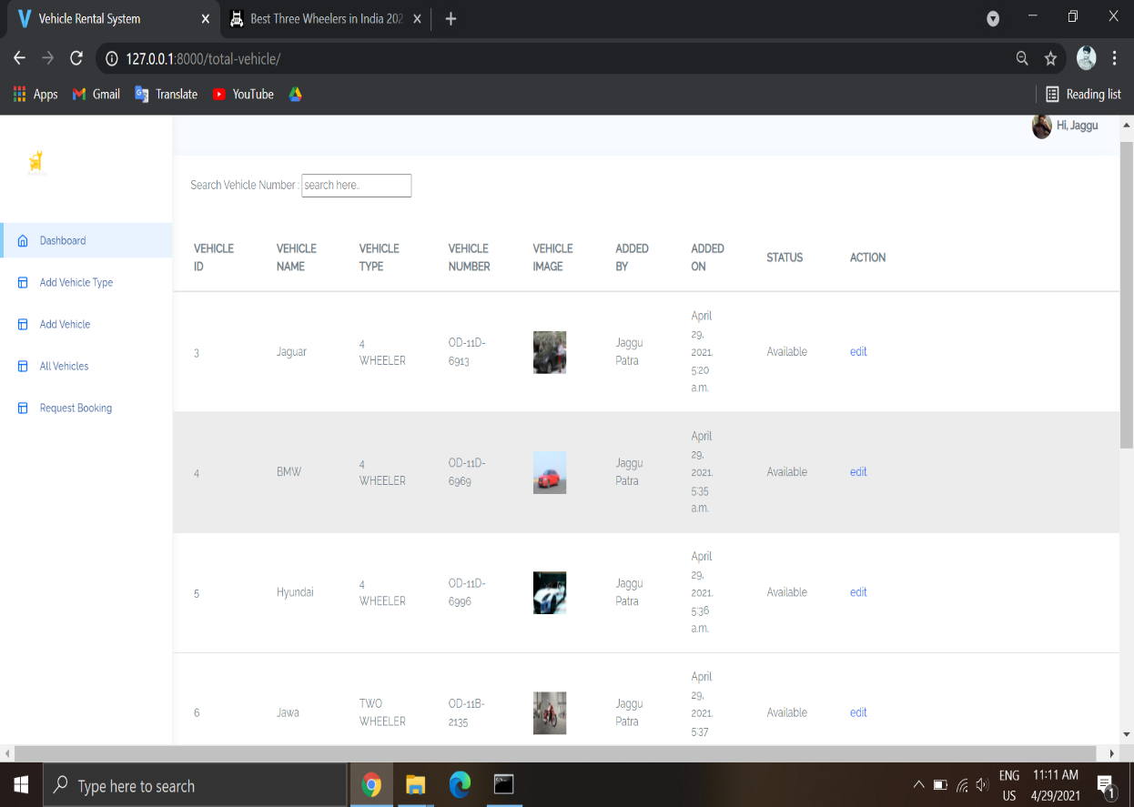
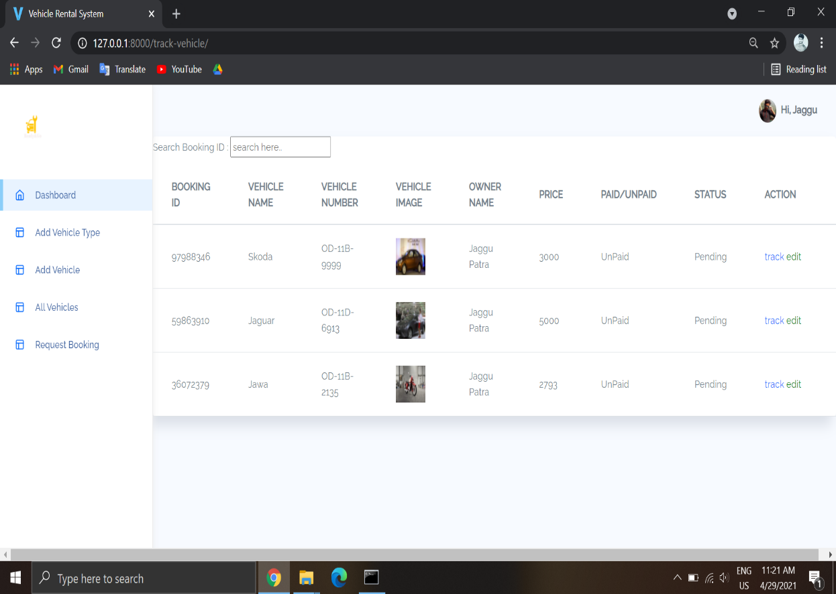
OWNER

Slide 21
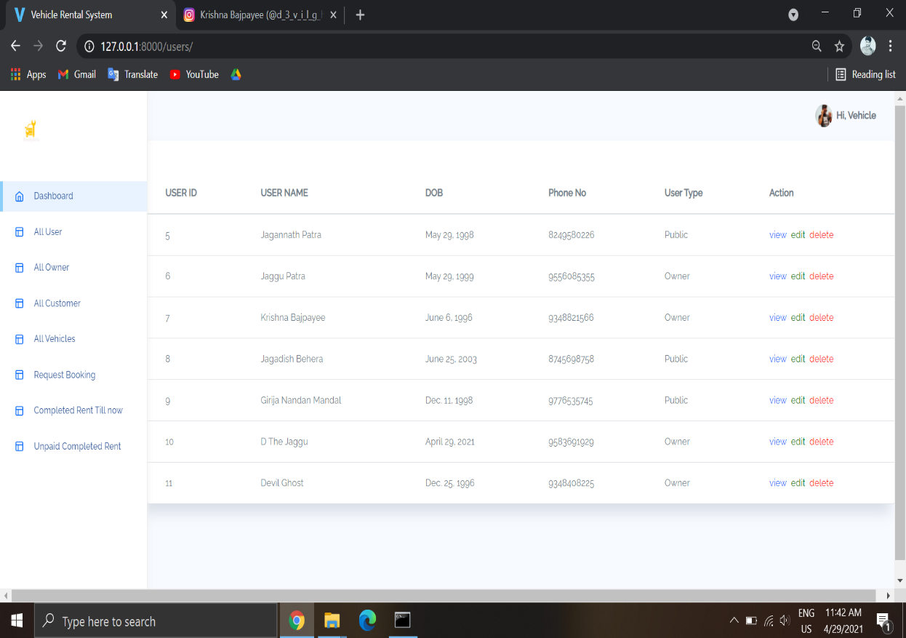
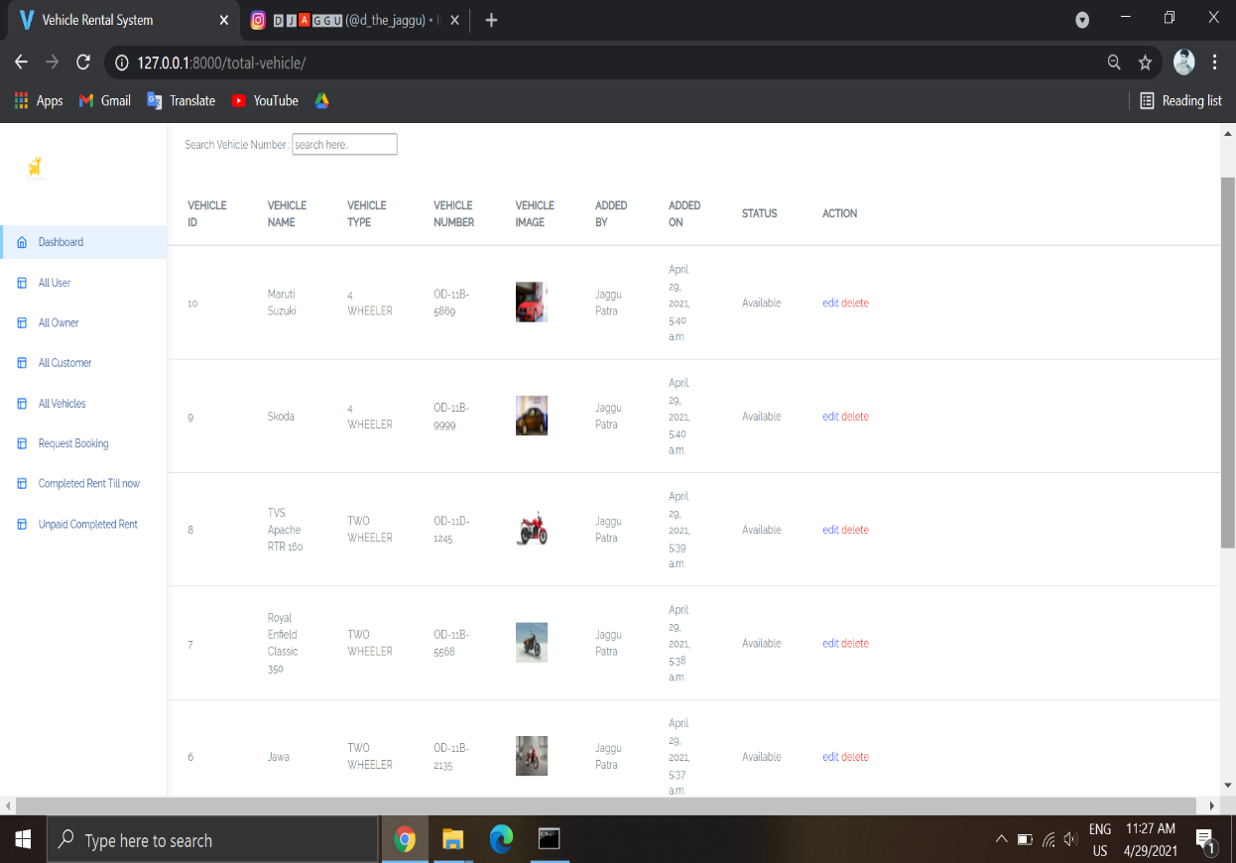
ADMIN

Slide 22
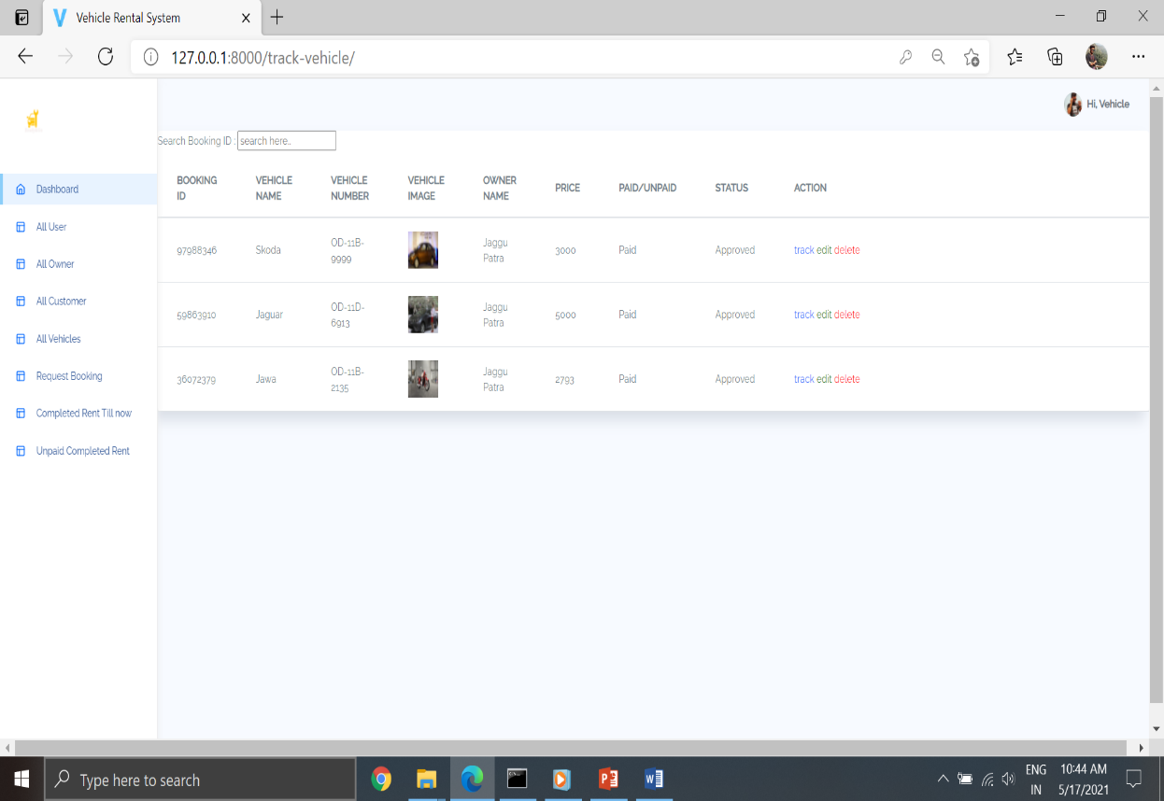
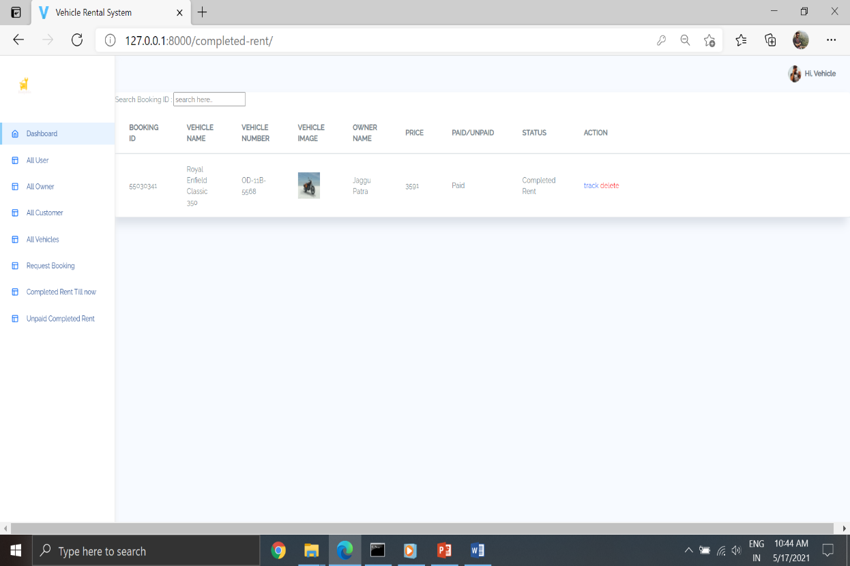
ADMIN

Slide 23
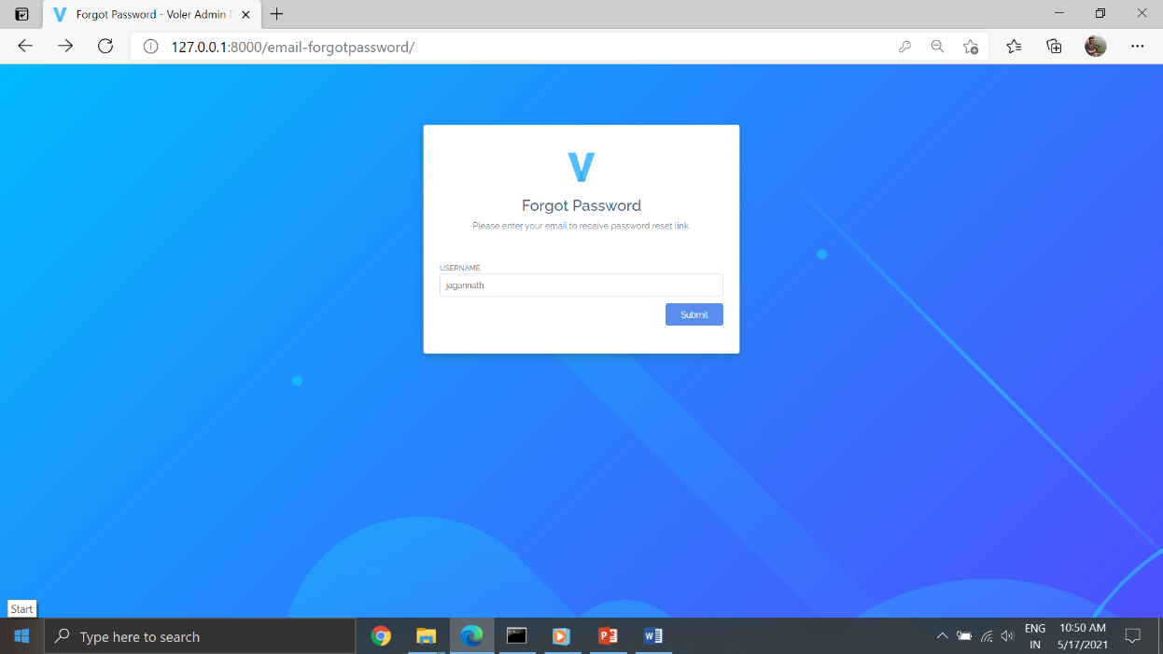
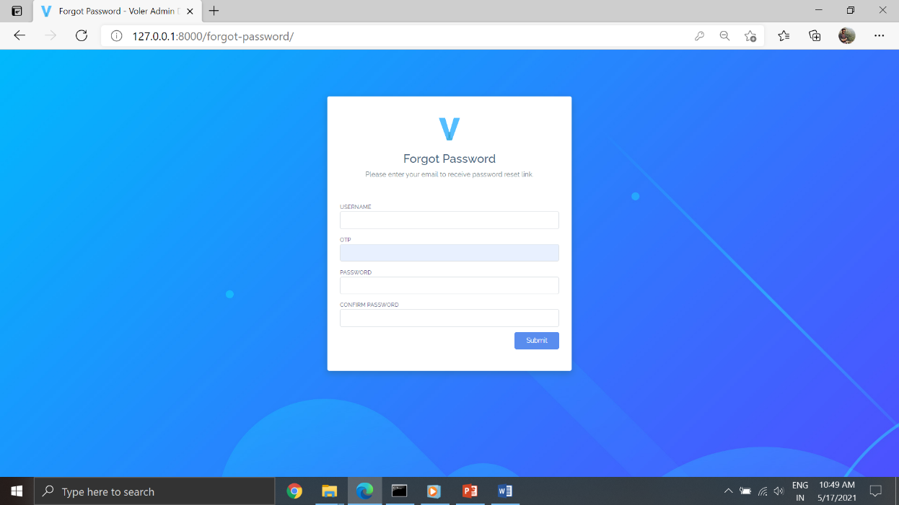
FORGOT PASSWORD

Slide 24
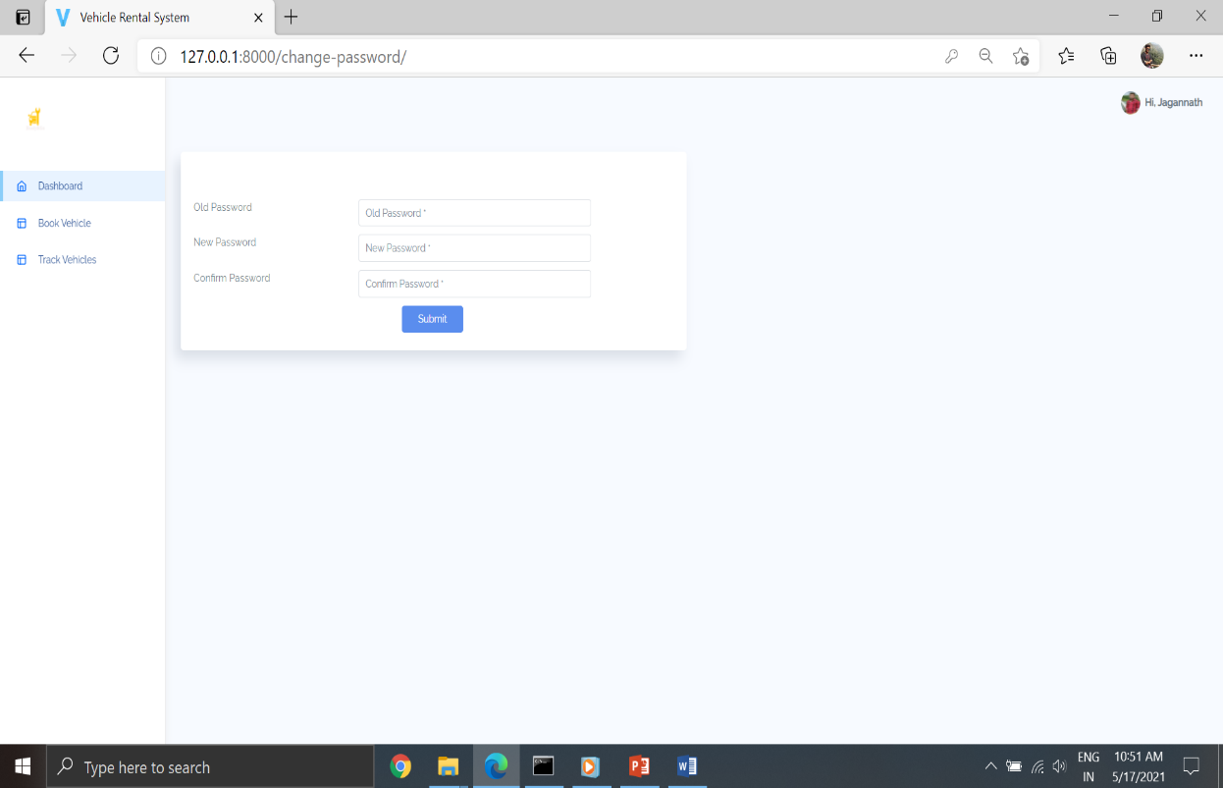
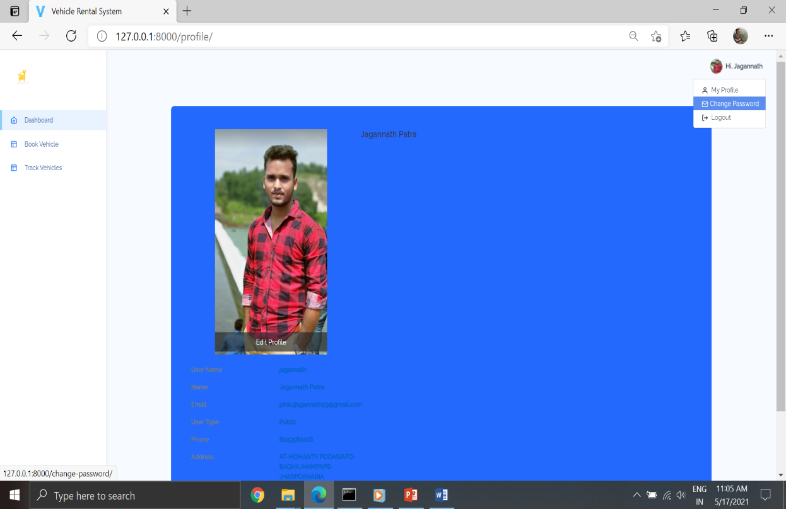
CHANGE PASSWORD

Slide 25
FUNCTIONAL REQUIREMENTS OF CUSTOMERS
Customers can go through this software to book vehicles by logging into this system and providing their id details.
After booking, customers can track their vehicle status which will be accepted or rejected by the vehicle owner.

Slide 26
FUNCTIONAL REQUIREMENTS OF VEHICLE OWNER
A registered vehicle owner can log in into this system and can add the type of the vehicle and can add vehicles.
After adding the vehicles that can display all the information of the vehicles.
The owner can manage the booking requests which are booked by the customers.

Slide 27
FUNCTIONAL REQUIREMENTS OF ADMIN
Admin can manage all the users as well as customers and vehicle owners.
admin can also manage all the vehicles and also can manage all the completed booked vehicles.

Slide 28
CONCLUSION
Our goal is to provide a very user friendly customer registration system who want to take vehicle for rent.
A special thanks to our mentor for guidance and blessing which he have provided for the completion of our project.

Slide 29

THANK YOU

